Slide 1

Toolkit Doc28 Projector
March 1, 2011

Slide 2
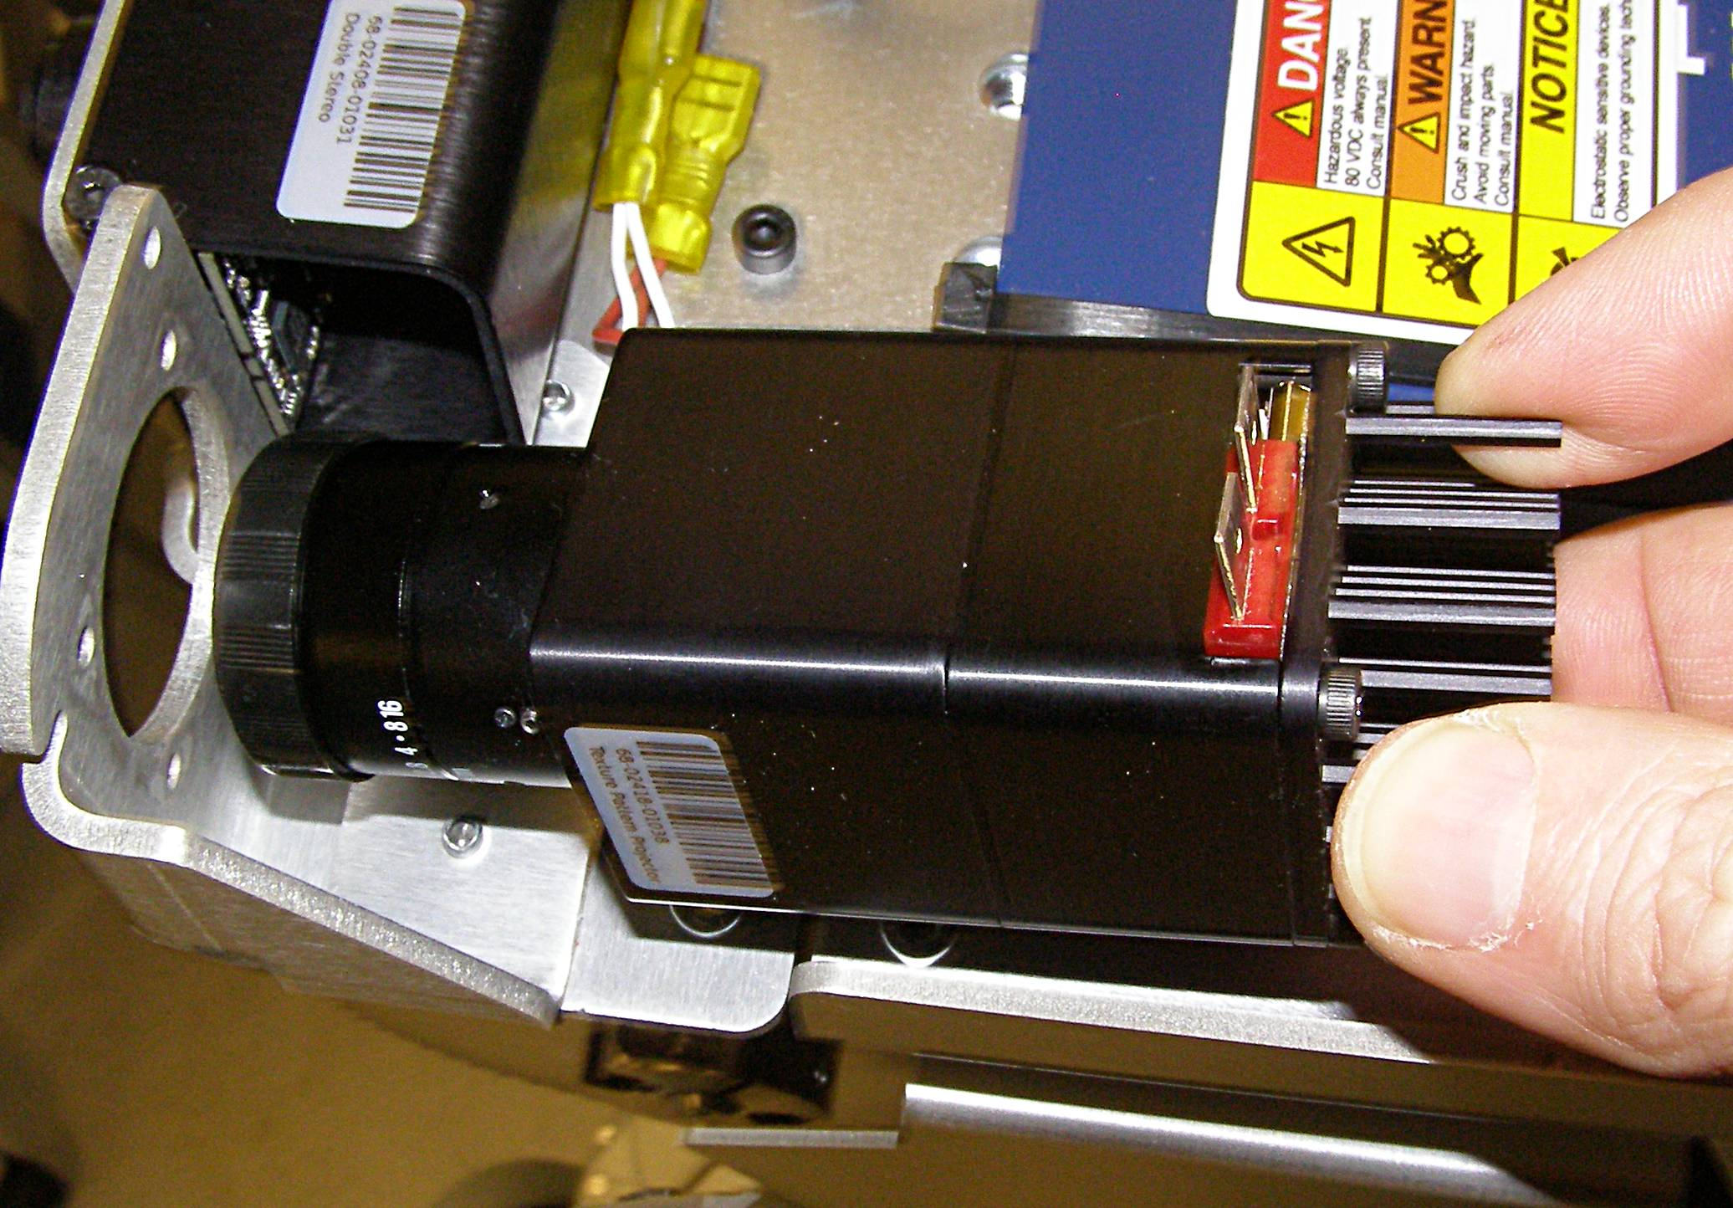
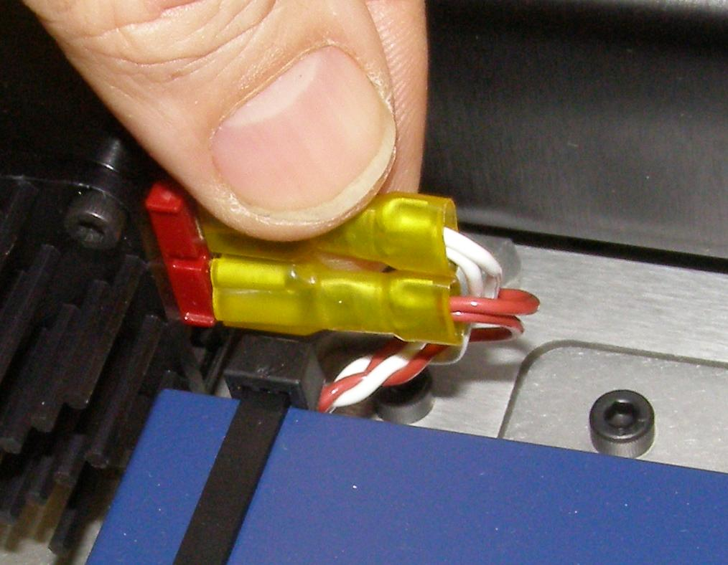
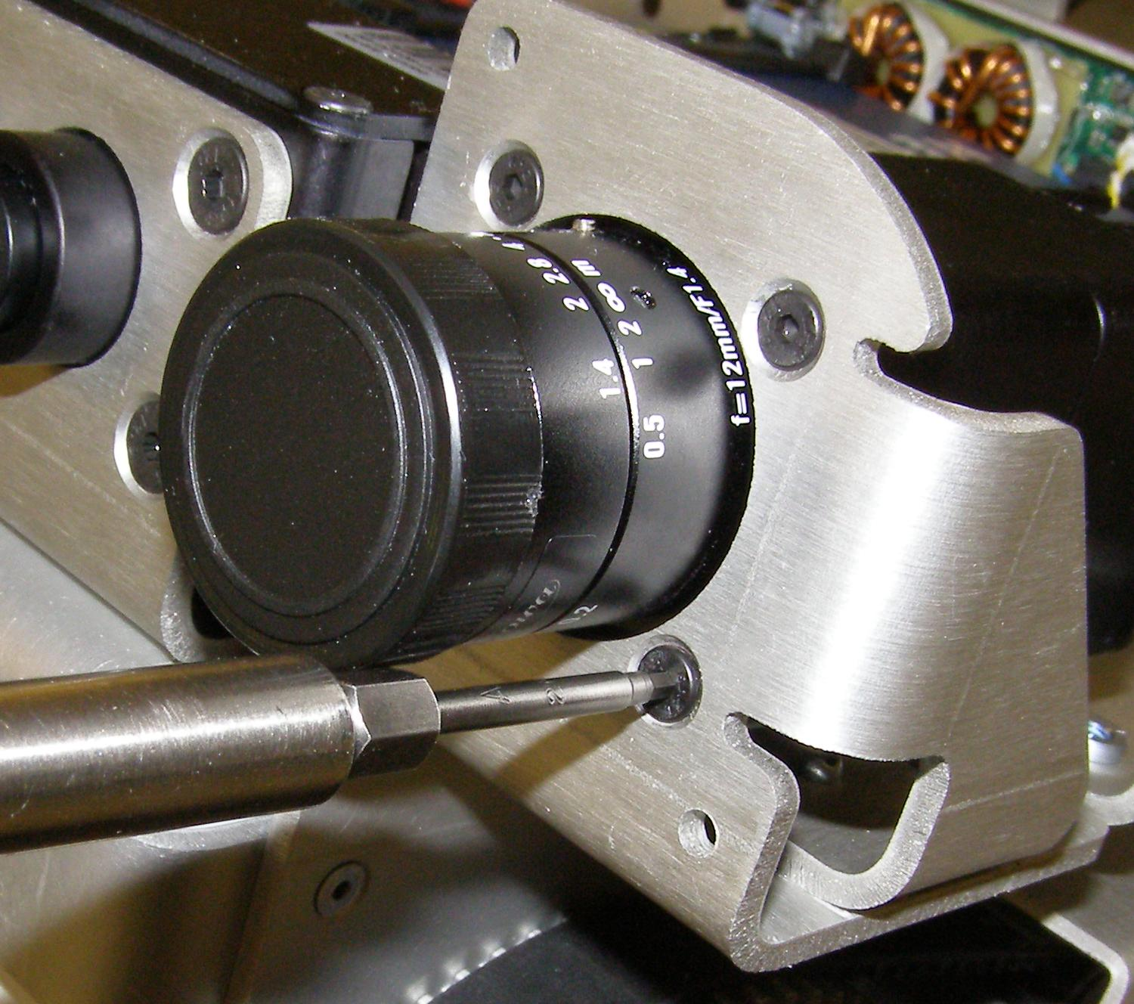
Projector R/R
Refer to the PR2 Overview document for additional information.
Make sure the Robot is turned off and unplugged from wall power.
Remove the Head Pan Tilt Left. (Doc11)
Remove the Head Pan Tilt Right. (Doc11)
Remove the Head Hatch. (Doc12)
Remove the Head Bezel Rear. (Doc12)
Remove the Head Bezel Front. (Doc12)
Remove the Head Bonnet. (Doc12)
Unplug the two Yellow Quick Disconnect connectors on the rear of the Projector body. You may have to wiggle them to get them off. (Fig. 1)
Using the 2mm bit together with the T-handle driver, remove the 4 mounting screws. (Fig. 2)
Lifting the back of the Projector, first rotate the Projector 90 degrees so that the power connections will clear the Ethernet Hub, then remove the Projector from the rear being careful not to damage the lens assembly. (Fig. 3)
Reverse the removal procedure.
Carefully feed the Projector lens through the mounting hole, then rotate back 90 degrees so the power connectors are facing towards the center of the Head.
Using Loctite 248, install the 4 screws and torque to 1.36Nm using the Large torque driver.
Plug the two power connectors back in, with the White wires on top and the Red wires on the bottom. (Fig. 1)
Follow the installation procedures in Doc11 and Doc12 to reassemble the Head covers.
Fig 1
Fig 3
Fig 2

